Slide 1
Unix Recap – Lab. 3
Faculty of Mathematics and Computer Science

Slide 2
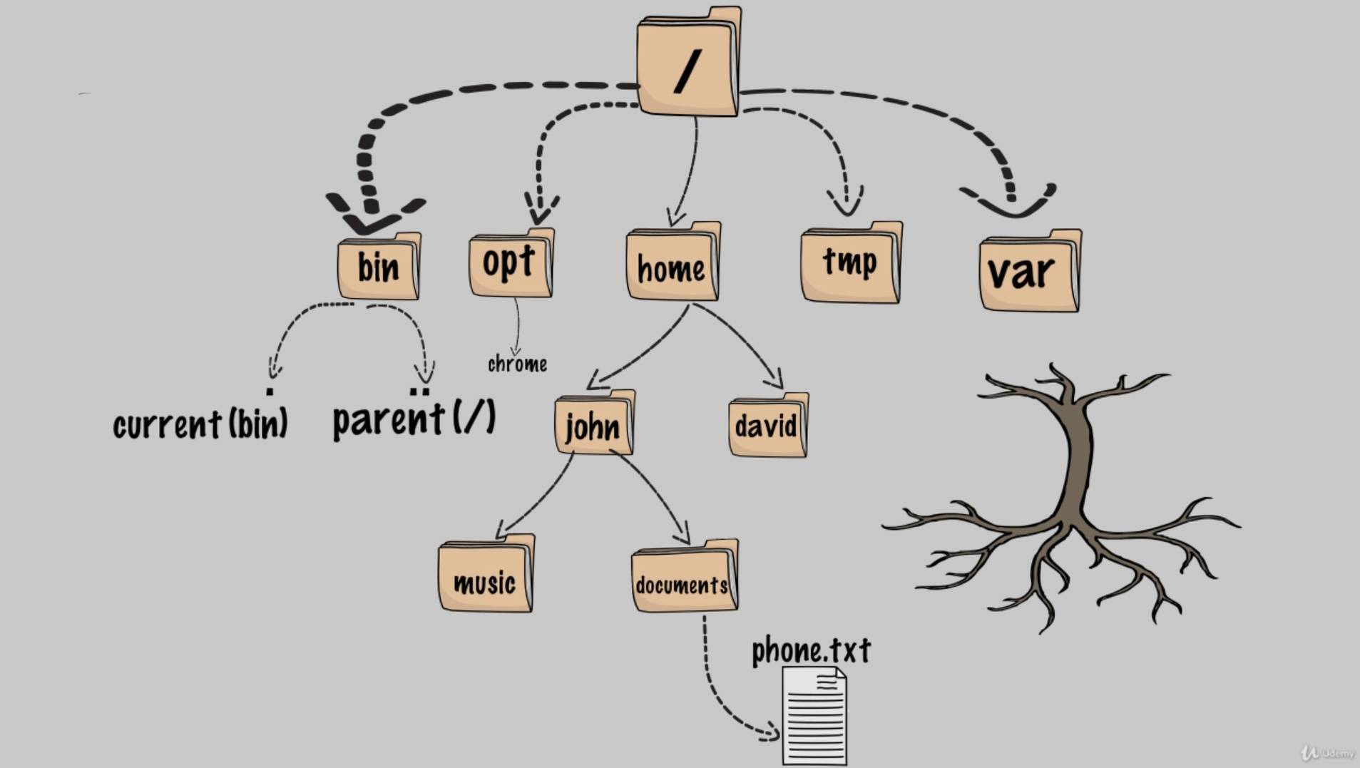
The directory tree
Notes:
Structura fisierelor in Linux:
-structura fisierelor linux sunt sub forma de arbore (aka directory tree);
-intr-un folder stochezi multiple fisiere si folosesti foldere ca sa iti organizezi info;
-in linux, noi numim folderele de fapt directoare;

Slide 3
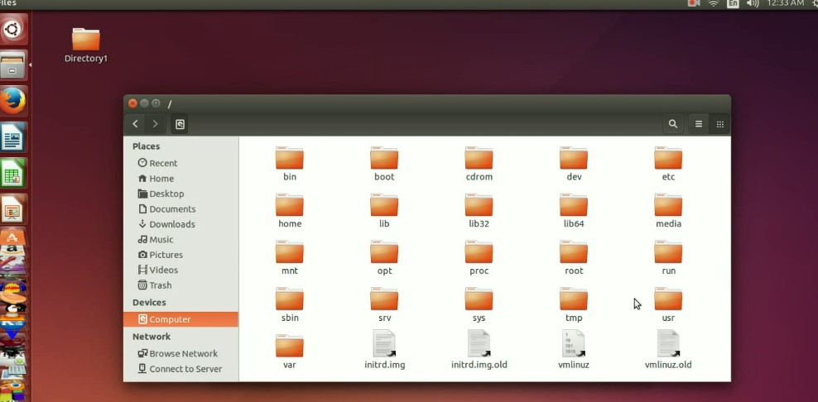
The directory tree

Slide 4
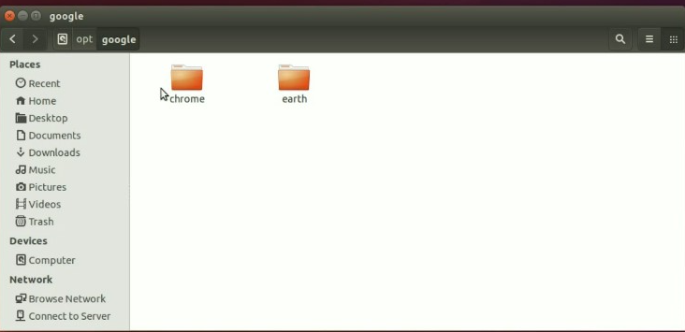
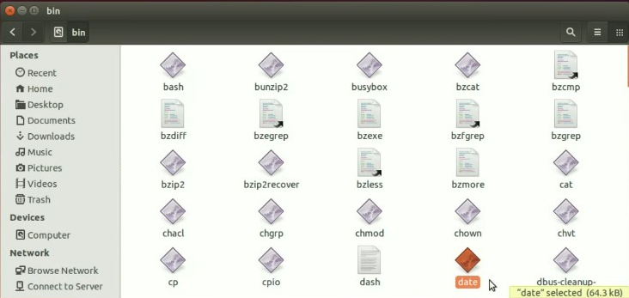
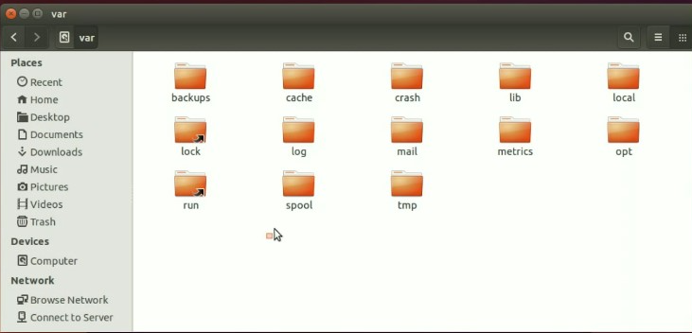
The directory tree

Slide 5
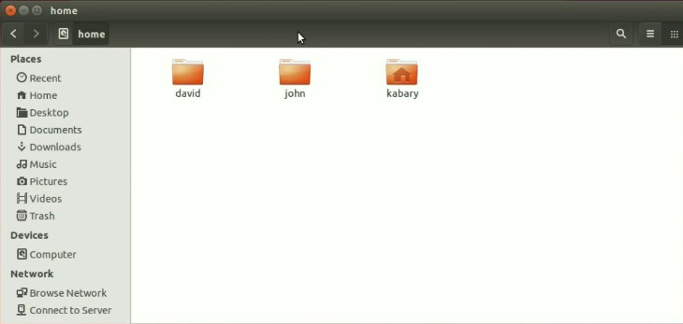
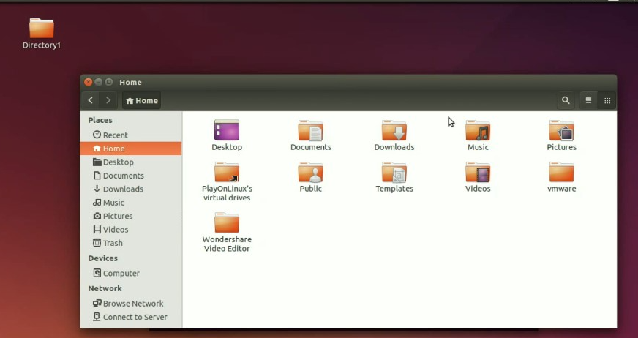
The directory tree

Slide 6
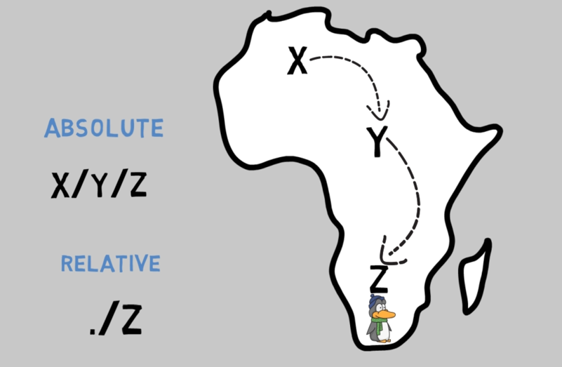
Absolute vs. relative path

Slide 7
5 minutes practice
Navigation commands
ls
ls /
ls ~
ls ..
ls –l
ls –a
ls -F
ls /home/xdianaelena
/Desktop
pwd
ls
cd
cd /
cd –
cd ..
cd ~
Notes:
Navigate the Linux File system

Slide 8
Quiz:
Navigation commands
Which character is used to represent the root directory ?
.
\
/
..
~
Which of those will be a valid absolute pathname of the file
numbers.txt ??
/home/xdianaelena/documents/numbers.txt
home/xdianaelena/documents/numbers.txt
./documents/numbers.txt
Under which directory can you find google earth program
(not installed by default) located ?
tmp
home
opt
Notes:
Navigate the Linux File system

Slide 9
5 minutes practice
Working with files
Listing Files and Modifying Timestamps:
Open a terminal
Run the following command to list all files and timestamps: ls –l
Create/update a file called Templates using:
touch Templates then do again the ls –l to see changes
2. Creating and Removing Empty Directories:
Go to Desktop with cd Desktop
Create a new directory named Exemplu with mkdir Exemplu
Create three additional directories with: mkdir a b c
Clear the terminal with clear
Do a ls –l to verify if the new directories were created
Remove empty directories: rmdir a b c
3. Creating and Removing Non-Empty Directories:
Go to Exemplu directory with cd Exemplu
Create a new empty file with touch ex1.txt
List contents ls
Go back to previous directory using cd ..
Try to remove Exemplu with rmdir -> error: failed to remove directory
Remove a directory forcefully with files inside: rm –R Exemplu

Slide 10
Quiz:
Working with files
1. Assume that dir1 is an empty directory. Which of these commands will remove dir1 ?
rm dir1
remove dir1
rmdir dir1
del dir1
2. Assume that dir1 is a non empty directory. Which of these commands will remove dir1?
rmdir dir1
rm –R dir1
rm –f dir1
3. Assume that dir1 is a non empty directory and text1 is just a text file. Which of these commands will successfully remove dir1 and text1 ?
rm text1 dir1
rm –v text1 dir1
rm –R text1 dir1

Slide 11
5 min practice
Working with files - Copy/mv files
Create a new directory and inside the directory create a file named file1.txt. Use the cp command to create a copy of this file. The command is: cp file1.txt file2.txt
Create a new directory inside the existing directory. If you want to copy file1.txt and file2.txt in the new directory, do: cp file1.txt file2.txt dir1
Copy dir1 into dir2 with cp –R dir1 di2, try first cp dir1 dir2 to see what happens
Go to Exemplu directory, create a new file called ubuntu and rename it to fedora using: mv ubuntu fedora
Make the file hidden using this command: mv fedora .fedora, then make it visible again
Create a new directory named dir1 and move the fedora file into the new directory with: mv fedora dir1
Create three new files and move them into the dir1 directory

Slide 12
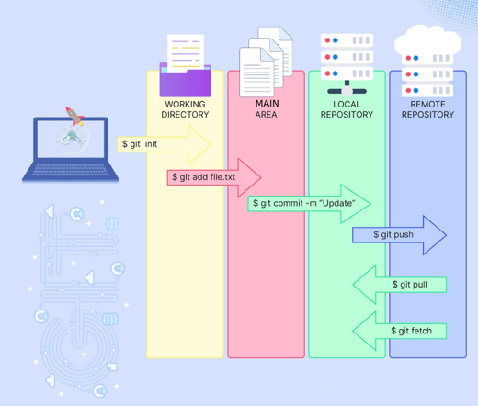
Basic Git Workflow – Why version control matters in Unix?
https://git-scm.com
Notes:
✅ Track Changes: Keeps a history of modifications to files, enabling easy rollback. ✅ Collaboration: Allows multiple users to work on the same project without conflicts. ✅ Backup & Recovery: Prevents data loss by storing different versions of a file. ✅ Experimentation: Enables branching and merging for testing new features safely. ✅ Automation & Deployment: Integrates with CI/CD pipelines for efficient software delivery.

Slide 13
Keyboards shortcuts
Ctrl + a
Ctrl + d
Ctrl + e
Ctrl + f
Ctrl + b
Ctrl + c
Alt + u
Alt + l
Ctrl + k
Ctrl + y
Ctrl +l

Slide 14
10 min practice
Text editors – editing files
1. Go to dir1. Try vi example1.txt.
Press INS key to change text then press ESC key to finish editing.
Press :w to save changes or :qw save changes and exit :q or :q! to exit without changes.
Verify your changes with cat example1.txt
2. Try vim example1.txt. Use the same commands like above.
3. Try nano example1.txt. Ctrl+X for exit. Create a file called dogs using nano dogs.txt
4. Go to lab3 and create dir5 dir6 and dir7 in one command mkdir …
5. Create 1 file in each directory named dir5_file1.txt, dir6_file1.txt, dir7_file1.txt.
Can be done in single command touch dir5/dir5_file1.txt dir6/dir6_file1.txt dir7/dir7_file1.txt
6. Copy dir5_file1.txt to directory dir6 without name, use cp command.
Use ls or tree to see results.
7. Move dir6/dir6_file1.txt to dir7 without specify a name. Use mv dir6/dir6_file1.txt dir7
8. Move file dir5_file1.txt to dir6 with name dir5indir6_file.txt.
Use tree to see results
9. Delete dir5 use rmdir command. Remove dir6
10. Use command less example1.txt to ONLY view the text content
Notes:
unix_text_editing_and_file_operations.sh -> for examples
Basic vi:
Press insert to insert some text
To get out press escape
Save changes :w
Exit without changes :q!
Vim este considerat o versiune extensa a vi. Vim are compatibilitate inversa cu vi dar nu se poate spune ca si invers. Stie de asemenea autocomplete si poate fi configurat prin intermediul unui fisier de configurare
Creating files:
touch – create empty files
cat – append text/create new file
vi/vim – visual editor
nano – text editor

Slide 15
Why use output redirection?
After learning how to create, move, and delete files, it’s important to understand how to control command output efficiently. By default, commands display results directly in the terminal, but what if you need to:
Save output for later analysis?
Redirect errors to a separate file for debugging?
Use output from one command as input for another?
✅
✅
✅
This is where data streams and redirection (>, >>, 2>, | ) come in.
Normally, commands print results to the terminal (stdout).
Errors are printed separately (stderr).
Redirection allows you to:
Save output (ls -l > files.txt)
Append output (ls -l >> files.txt)
Separate errors (ls /notfound 2> errors.txt)
Combine outputs (ls -l / 2>&1 | less)
✅
✅
✅
✅
Notes:
De ce să folosim redirecționarea ieșirii?
După ce ai învățat cum să creezi, să muți și să ștergi fișiere, este important să înțelegi cum să controlezi eficient ieșirea comenzilor. În mod implicit, comenzile afișează rezultatele direct în terminal, dar ce faci dacă ai nevoie să:
✅ Salvezi ieșirea pentru o analiză ulterioară? ✅ Redirecționezi erorile într-un fișier separat pentru depanare? ✅ Folosești ieșirea unei comenzi ca intrare pentru o altă comandă?
Aici intervin fluxurile de date și redirecționarea (>, >>, 2>, |).
În mod normal, comenzile afișează rezultatele în terminal (stdout).
Erorile sunt afișate separat (stderr).
Redirecționarea îți permite să:
✅ Salvezi ieșirea într-un fișier (ls -l > files.txt) ✅ Adaugi ieșirea la un fișier existent (ls -l >> files.txt) ✅ Redirecționezi erorile separat (ls /notfound 2> errors.txt) ✅ Combini ieșirile standard și erorile (ls -l / 2>&1 | less)

Slide 16
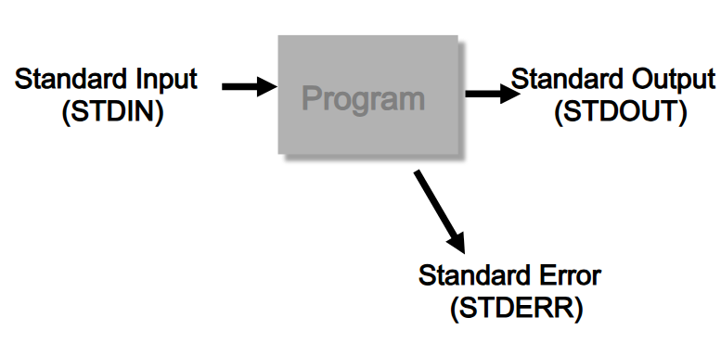
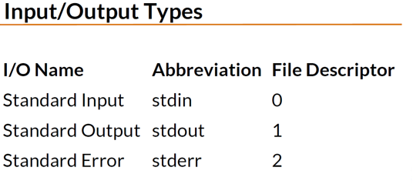
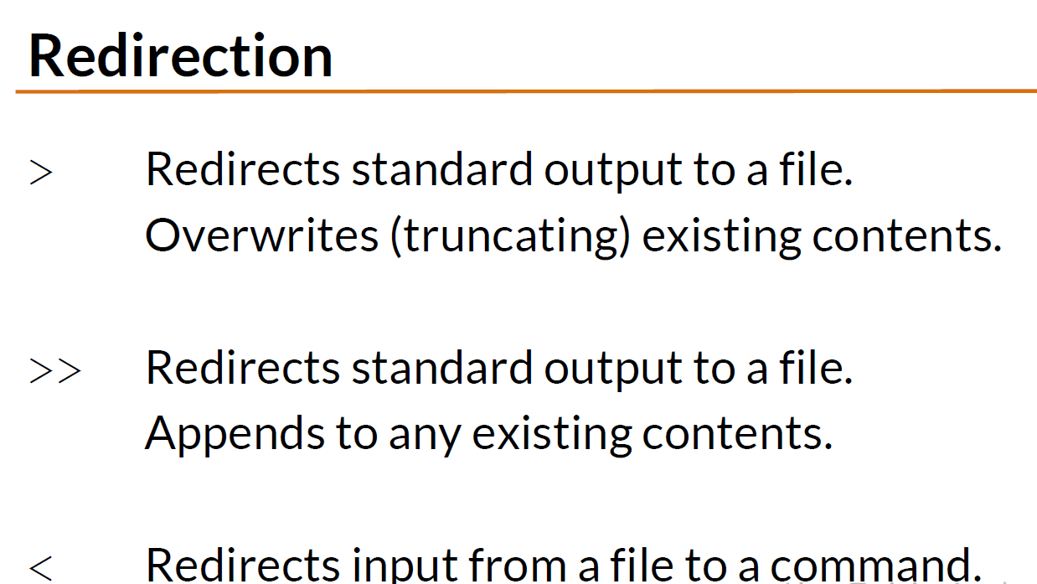
Data streams
Notes:
Fluxurile de date (Data Streams)
Tipuri de Intrare/Ieșire (Input/Output Types)
Nume I/O abreviere Descriptor de Fișier
Intrare standardstdin 0Ieșire standardstdout1 Eroare standardstderr2
Redirecționare (Redirection)
🔹 > → Redirecționează ieșirea standard într-un fișier.
Suprascrie conținutul existent al fișierului.
>> → Redirecționează ieșirea standard într-un fișier.
Adaugă conținutul la fișierul existent, fără a-l suprascrie.
< → Redirecționează intrarea standard dintr-un fișier către o comandă.

Slide 17
10 min Practice
Data streams
Create a file users.txt with some information. Use sort <users.txt This is a sample for stdin
Create directory structure mkdir dir1 dir1/dir1_1 dir1/dir1_2 dir1/dir1_3 dir2 dir2/dir2_1 . Execute ls -ls dir1 dir2 >stdout1.txt. cat stdout1.txt. This is in stdout stream redirection
Execute ls -l 1>list.txt by using file descriptor
Execute ls -ls dir1 dir2 >>stdout1.txt or ls -ls dir1 dir2 1>>stdout1.txt twice. Notice the result. This is an append stdout
Execute ls -ls /something 2>stderr1.txt
Execute ls -ls /something 2>>stderr1.txt twice
Execute ls –l dir1 dir2 /something 1>stdout1_1.txt 2>stderr1_1.txt
Execute ls –ls dir1 dir2 /something > output.txt 2>&1 put the output and error in the same file
Execute ls –ls dir1 dir2 /something >> output.txt 2>&1 twice append the output and error in the same file
Notes:
data-streams.sh
Creates users.txt and fills it with names.Uses sort < users.txt to demonstrate stdin redirection.Creates multiple directories using mkdir -p.Lists directories and redirects stdout (> and >>).Redirects stdout using file descriptor 1>.Captures errors using stderr redirection (2>).Merges stdout and stderr into one file using 2>&1.

Slide 18
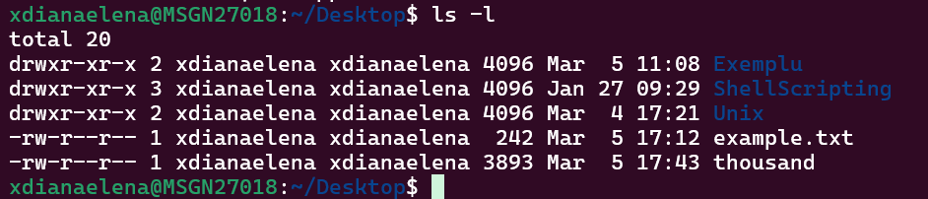
File permissions
In a UNIX/LINUX system, every file belongs to both an owner and a group, and ownership rules on the file define who is allowed to read, write or execute a particular file;
The 1st column of output is the file mode;
The 2nd column indicates the number of links;
The 3rd column shows the file owner;
The 4th column shows group in the file belongs to;;
The 5th column shows the file size in bytes;
The 6th column shows the month the file was created;
The 7th column shows the day of the month file was created;
The 8th column shows the time the file was created;
And the last column is the file name;
Notes:
Permisiuni pentru fișiere (File Permissions)
📌 În sistemele UNIX/LINUX, fiecare fișier aparține unui proprietar și unui grup. Regulile de proprietate și permisiuni definesc cine poate citi, scrie sau executa un fișier.
📌 Structura ieșirii comenzii ls -l
În exemplul din imagine, comanda ls -l afișează informații detaliate despre fișiere și directoare.
1️⃣ Primul camp Modul fișierului (file mode) – definește permisiunile (drwxr-xr-x, -rw-r--r-- etc.).
2️⃣ Al doilea camp Numărul de legături (hard links) – arată câte referințe există pentru acel fișier/director.
3️⃣ Al treilea camp Proprietarul fișierului (file owner) – utilizatorul care deține fișierul.
4️⃣ Al patrulea camp Grupul căruia îi aparține fișierul.
5️⃣ Al cincilea camp Dimensiunea fișierului în bytes.
6️⃣ Al șaselea camp Luna în care a fost creat fișierul.
7️⃣ Al șaptelea camp Ziua din lună când fișierul a fost creat.
8️⃣ Al optulea câmpOra exactă la care a fost creat fișierul.
Ultimul camp Numele fișierului sau directorului.

Slide 19
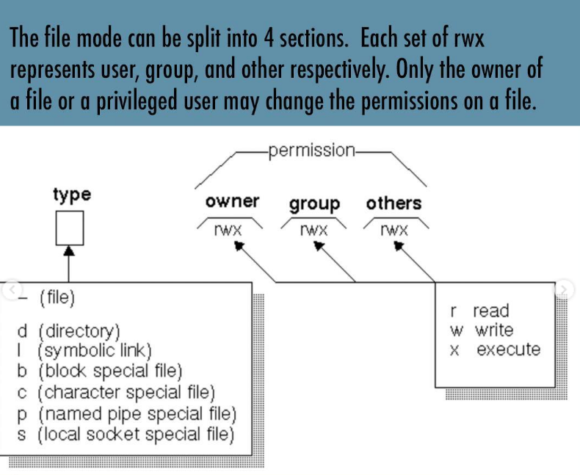

File permissions II
Notes:
chmod –to change permissions of a file or directory
Executable and shell scripts must have executable permissions

Slide 20
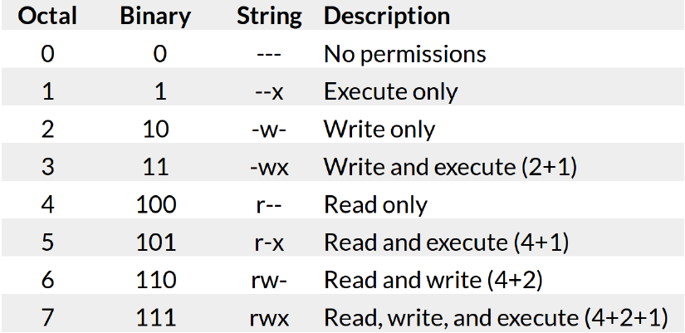


Permission Modes
How to change permissions
For example, to grant ONLY a file owner read, write and execute permissions, you would do:
To give the file owner all permissions, and the group read permissions, you would do:
Notes:
SCREENSHOT LINUX PERMISSIONS

Slide 21
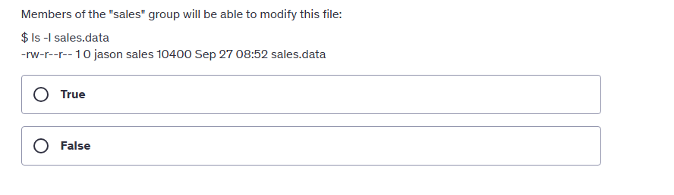
File permissions - Question

Slide 22
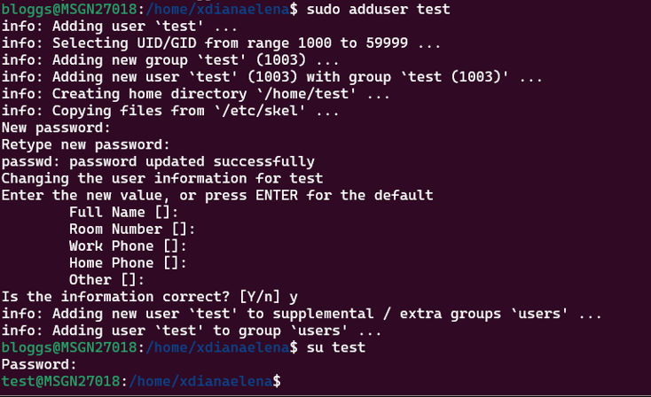
Create new user account in Linux
Notes:
CTRL + D sa iesi din sesiunea curenta

Slide 23
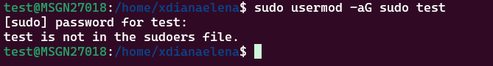
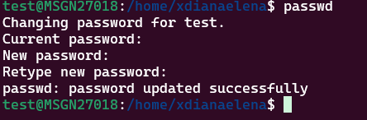
Grant admin privileges to a user/Delete user
User must be a root user or must have sudo privileges in order to create a new user;
After granting admin privileges to a new user, you can create another new user with this command: sudo usermod –aG sudo test
Command cat /etc/passwd lists all the existing users;
Command for changing the password to a user is passwd
To delete a user you must also have an administrative account or a root account;
The command for deleting a user is: sudo deluser username
Notes:
When you can’t delete a user because of a process id, do this:
ps -u test to see the PROCESS ID then
sudo kill -9 4402 4427
sudo rm -r /home/test

Slide 24
Practice
Create users/groups set user rights for directories/files
1. Create 3 users test_user1_1 test_user1_2 and test_user2. Can use any password but for safety would be recommended to use pwd=password sudo adduser [username]
2. Run the command cat /etc/group. Run groups cmd for one of new user created and for your current user groups [user_name]. Run also id [user_name] for one of new users added and for your user. Try to understand what you see there
3. Add 2 new groups group1 group2. Use for that command sudo groupadd [group_name]. After you finish verify that groups were added. See above how. Also you can check that by using command getent group [group_name] getent – get entity
4. Add test_user1_1 and test_user1_2 to group1 and test_user2 to group2. usermod -aG [group_name] [user_name]. Use command getent group [group_name] to see that users added to group.
5. Open 3 terminal windows for each new user created. Do not close terminal used until now
6. Try to create a new user by using terminal open from test_user1_1. What’s happening ?. Ok let’s fix and allow our user to be able to execute sudo commands
7. Open initial terminal session (student one) and add test_user1_1 to sudo group. sudo usermod -aG sudo test_user1_1
8. Close session for test_user1_1 (Ctr+D) and login again. Try step 6. ☺ You accomplish first sudo rights settings.
9. Go to test_user1_1 be sure that you are in user folder and create a folder called lab_3
10.Go to test_user1_2 and try to enter into folder home/test_user1_1. You can’t.
Why? look at rights and group for home/test_user1_1
11.Let’s change test_user1_1 folder to be part as group1.sudo chgrp group1 test_user1_1.
Run command from test_user1_1 terminal
12. Try again step 10. Now you can access folder content. Try to enter folder lab3
Is not possible. Look at permissions. Execute again step 11 with –R option.
Try again. Now you can access lab3. Look at permissions
UNIX access rights
Notes:
unix_user_management.sh
Creates three users: test_user1_1, test_user1_2, and test_user2.Displays group information for the new users and the current user.Creates two new groups: group1 and group2.Adds users to groups and verifies their membership.Adds test_user1_1 to the sudo group to enable sudo commands.Creates a folder (lab_3) in test_user1_1's home directory.Tests access restrictions by trying to enter test_user1_1's home directory from test_user1_2.Changes the group ownership of test_user1_1's home directory to group1.Re-attempts access to verify group permission changes.Recursively changes ownership of lab_3 so group members can access it.

Slide 25
Practice
Create users/groups set user rights for directories/files
13.Go to /home/test_user1_1. Try to create a folder mkdir testdir. Is not possible. Go to home look at permissions. Why ?
14.Ok so the users from group doesn’t have right for write. Go to test_user1_1 and execute chmod g+w /home/test_user1_1. Go to /home an look at permissions
15. Repeat step 13 (in test_user1_2 terminal). Ok now it’s possible to create testdir. List folder content. Notice that new directory created is owned by test_user1_2 and is under group test_user1_2
16. Go to test_user2 terminal. Try to access cd /home/test_user1_1. Try to list ls /home/test_user1_1 It’s not possible because for that folder test_user2 is considered in others category
17. Go to test_user1_1 terminal and change rights for others chmod 774 home/test_user1_1. Go back to test_user2. Try cd /home/test_user1_1 and try ls /home/test_user1_1.
18. Go to test_user1_1 terminal and change rights for others chmod 777 home/test_user1_1. Go back to test_user2. Try cd /home/test_user1_1 and try ls /home/test_user1_1. Now try mkdir /home/test_user1_1/testdir
19 Delete test_user1_2 from group1 gpasswd -d test_user1_2 group1
20 Try to see what’s happening when try to access /home/test_user1_1 from test_user1_2 terminal
21 sudo deluser --remove-home test_user2. Look to messages when command executed. Look in home
UNIX access rights
Notes:
unix_permissions_and_user_management.sh
Attempts to create a directory inside /home/test_user1_1 (fails due to lack of write permissions).Adds write permission for the group (chmod g+w) so group members can write.Tries creating the directory again, which should now succeed.Checks that test_user2 cannot access /home/test_user1_1.Changes permissions of /home/test_user1_1 to 774 (read, write, execute for owner and group, read-only for others).Changes permissions of /home/test_user1_1 to 777 (fully open access).Verifies test_user2 can now enter and create files.Removes test_user1_2 from group1 and verifies access.Deletes test_user2 along with its home directory using deluser --remove-home.

